Slide 1

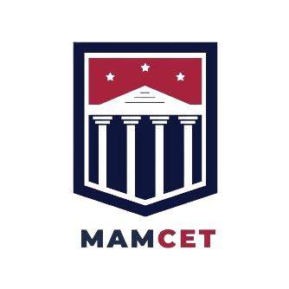
NIT- DATANETIIX HACKATHON
Animal Image Classification System in Deep Learning Pre-trained Models using Transfer Learning Techniques Prediction and An Ensemble Learning Approach
PRESENTED BY,
Manikandan .M
Gunaseelan. R

Slide 2

AGENDA
1. ABSTRACT
2. PROBLEM STATEMENT
3. INTRODUCTION
4. LITERATURE SURVEY
5. BLOCK DIAGRAM
6. METHODOLOGY
7.CONCLUSION

Slide 3
ABSTRACT
• Score Level Fusion of an animal biometric detection system that identify with the growing research on an animal information.
• The Transfer learning is a technique where it will use prediction to find the model that has train on large amount information for this problem.
• To overcome this proposed model using pre-trained networks only train by fine-tuning the model and the main advantage it will get the model to train in a short period.
• It is the models are DenseNet_201,ResNet_101,InceptionV3 and Vgg16 these all pre-trained architectures are classify it.
• Then, finally the prediction of an animal classification is compare to transfer learning models gives better accuracy result.

Slide 4
PROBLEM STATEMENT
• Animals contain flexible structure, self-mask, and appear in complex scene. It is also all objects, appear under different illumination conditions, viewpoints and scales
• Animal classification which relies on the problem of
distinguishing images of different animal species an easy task for humans

Slide 5
PROBLEM STATEMENT
• Animals contain flexible structure, self-mask, and appear in complex scene. It is also all objects, appear under different illumination conditions, viewpoints and scales
• Animal classification which relies on the problem of
distinguishing images of different animal species an easy task for humans
OBJECTIVE
• The main objective is to develop a system which will use computer vision approaches for the classification of animals are pre-trained models using in the technique with an ensemble model

Slide 6
INTRODUCTION
Identification of animals the biggest challenge is to observing dangerous animals is killing people
An automated Score Level Fusion method of an animal biometric recognition system is identified with the growing research on animal information. The modern inspection is an identification and classification system implemented from animal images achieved by technology
Deep Learning (DL) is established to be a powerful deciding and recognition of the information delivered to the system. The proposed system can be applying Deep Learning pre-trained models, for animals and the classification of the dataset

Slide 7
S.No | Title of the paper | Year | Comments
1 | Performance evaluation of score level fusion in multimodal biometric systems | 2010 | Three biometric characteristic is face. SVM based fusion and sum rule is based on reduction of high scores effect (RHE) normalization leads to high accuracy
2 | Content-based Classification and Retrieval of Wild Animal Sounds using Feature Selection Algorithm | 2010 | 6 class of animal images two different classifiers are K-Nearest Neighbor and Multi-Layer Perceptron Classifiers used the accuracy respectively 63% and 68%
3 | Automated identification of animal species in camera traped images | 2013 | 18 species of 7000 images - SIFT and cLBP as descriptors of local images features and SVM classifier used significantly improved the recognition performance 82%
4 | Classification of Wild Animals Based on SVM and Local Descriptors | 2018 | Slovak country site 5 class of animals BOW and SVM classifier are 86% accuracy and key points detector method is 80%

Slide 8
EXISTING SYSTEM
The system of classification to contribute the researchers construct the difficult structures has to denote and categorize the pictures can be improved but production of the eye, the nose is to find a challenging task
The process of feature can be extracting various techniques and joining them then constructing better features. It has raised the size then it affects to give growing the computational cost
The existing methods of concluding prediction are not given the similar and dissimilar identification of a mixture of animal classes
To overcome these challenges by using the multi-model system to extract the features that present match-score method called score fusion technique

Slide 9
PROPOSED SYSTEM
The system of finding the classification of figures can predict the results. It is based on the classifier used in the features to be selected and classify the methods
The method of classification uses the features of convolutional neural network (CNN) layers for classifying animal images classification
The Algorithm is used for mainly extracting characteristics and classifying, and gaining knowledge of general
It is after that pre-processing step, the classifier performs Gabor filters, and methods are used in the proper demonstration process it can easy to predict the final result

Slide 10

BLOCK DIAGRAM
ResNet-101
VGG 16
Ensemble
Learning
Animal Prediction
Inception V3
DenseNet-201

Slide 11
METHODOLOGY
Transfer Learning Models
ResNet-101
VGG16
DenseNet _201
InceptionV3
Ensemble Learning
It is a machine learning technique that combines several
base models in order to produce one optimal predictive model

Slide 12


HARDWARE AND SOFTWARE REQUIREMENTS
Hardware Requirements
System of Processor : Intel Core ™ i5-6006U CPU @ 2.00Hz Minimum
Hard Disk : 500 GB.
Ram : 16 GB.
Moniter : 15 inch.
Software Requirements
Operating of the system : Windows 10
Implementation of
Language : Python (version 3)
Framework : Anaconda
Platform of the system : IDE Jupyter Notebook, pycharm

Slide 13

WORKING
In human’s it is difficult to analyze the forest’s wild animals 24/7
This drawback is overcome by send the UAV Like drones and rovers etc…
Those vehicle capture the images of animals and gives it to Algorithm
Based upon the images the CNN classify the animal and give the better accuracy with probability scores.

Slide 14
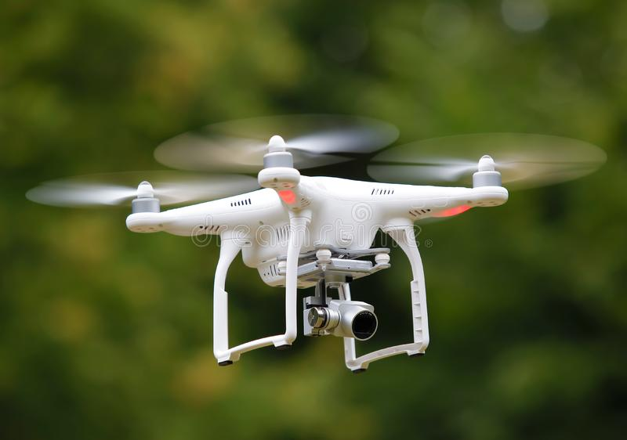
APPLICATIONS
In forest, human involving deforestation activities the UAV captured images and send to the forest control, it makes alert sound.
In any new human inside the forest , the data set are find the authenticated person or not.
It is mainly used in the animal classification which classify and categorize the animals.

Slide 15

CONCLUSION
• A novel animal classification system is the proposed system based on the method transfer Learning and score-level fusion pairs
• It is used An Animal using ImageNet database. Then, augmentation and pre-processing the image using the gabor filters and performing process
• It is to demonstrate the proposed method using score-level fusion on pre-trained models architecture for animal classification
• Finally, the classification system using pre-trained model improve the accuracy

Slide 16
REFERENCES
A Navneet Dalal and Bill Triggs.: ‘Histograms of Oriented Gradients for Human Detection’ : Computer Vision and Pattern Recognition, IEEE, (2005)
Mikolajczyk, Krystian, and Cordelia Schmid.: ‘A performance evaluation of local descriptors.’ : Pattern Analysis and Machine Intelligence, IEEE Trans (2005)
Krizhevsky, A., Sutskever, I., & Geoffrey E., H.: ‘ImageNet Classification with Deep Convolutional Neural Networks’: Advances in Neural Information Processing Systems, (2012)
Chen, C. H., & Chu, C.: ‘Fusion of face and iris features for biometrics’ : Advances in Springer ,(2005)
Marcialis, G, Roli, F.: ‘Score-level fusion of fingerprint and face matchers for personal verification conditions’ : IEEE Int. Analysis ,(2007).

Slide 17
REFERENCES
6. Sim, H, Hishammuddin, A, Rohayanti, H, ‘Multimodal biometrics: weighted score-level fusion based on non-ideal iris and face images’, Expert Syst. Appl., (2014).
7. Mina Farmanbar, onsen Toygar, ‘Feature selection for the fusion of face and palmprint biometrics’, Springer-Verlag London, (2015).
8. K. He, X. Zhang, S. Ren and J. Sun.: ‘Deep residual learning for image recognition’: Proceedings of the IEEE Conference on Pattern Recognition, (2016).
9. P. Moeskops, M. Veta, M. W. Lafarge, K.A. Eppenhof.: ‘Adversarial training and dilated convolutions for brain MRI segmentation’: in Deep Learning in Medical Image Analysis, Springer, (2017).
10. Fahad Alharbi , Animal species classification using machine learning techniques, MATEC Web of Conferences , (2018 )

Slide 18
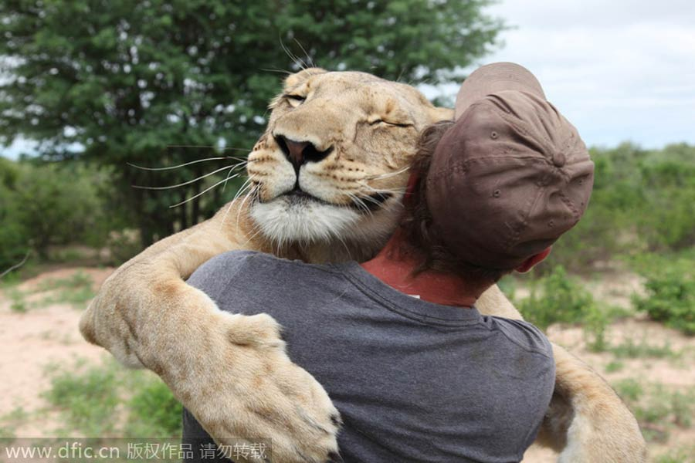
THANK YOU …!

